Slide 1

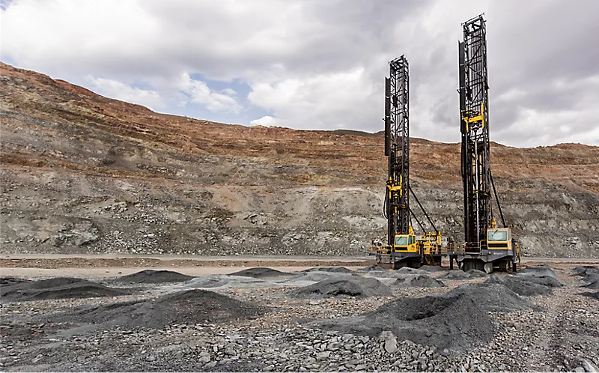

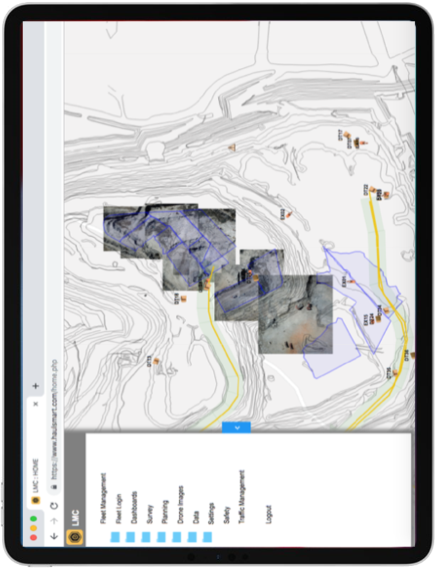
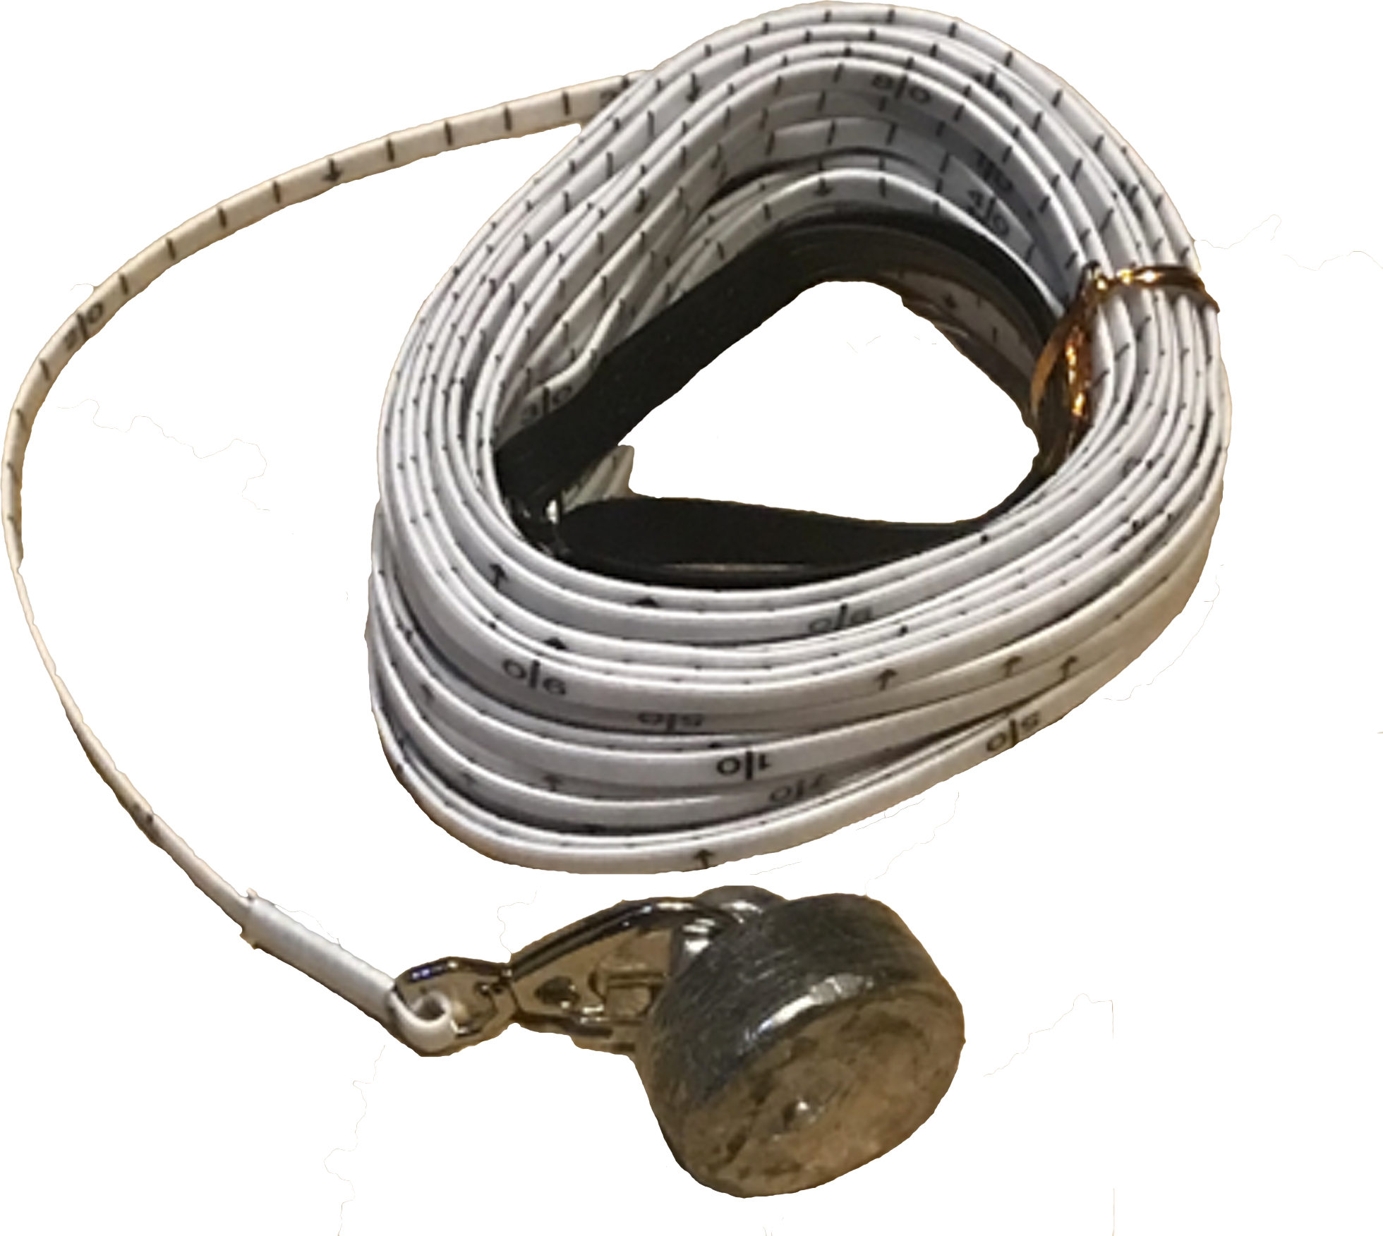

Slide 2
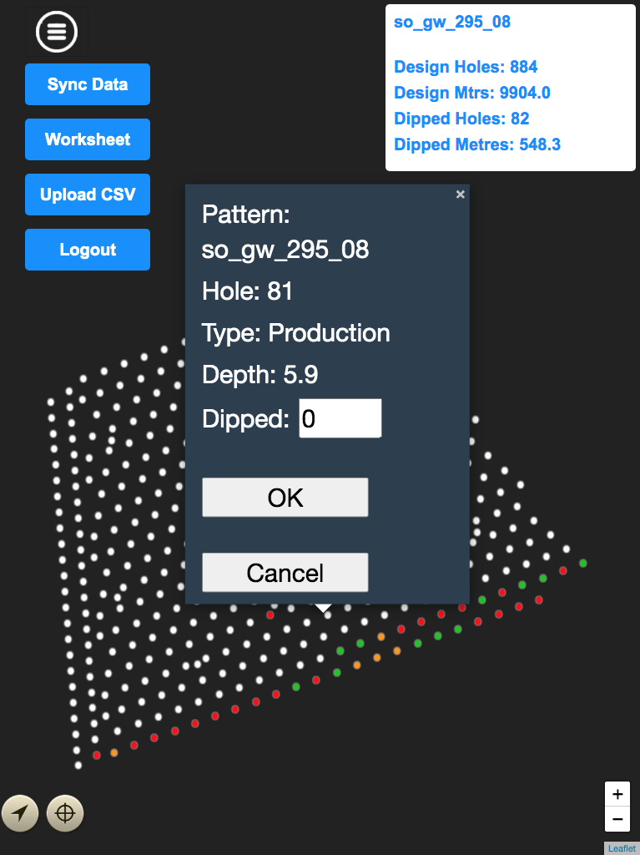

Slide 4
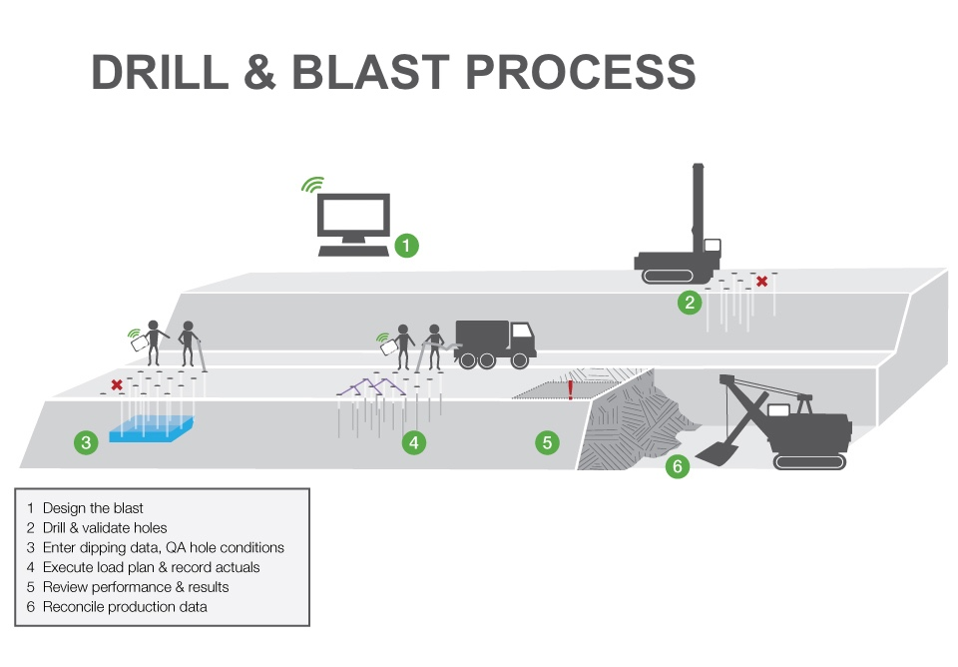

Slide 5
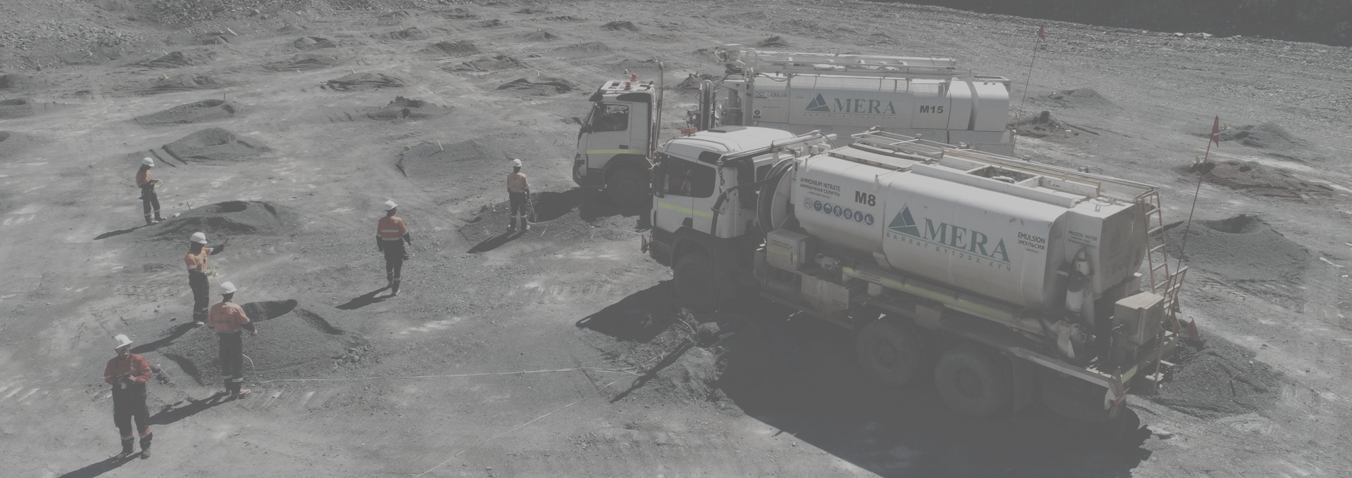

IndexedDB preferred storage due to internet network constraints

Slide 6
Users login with internet connection and then manually sync IndexedDB with HaulSmart API.

Slide 7
App uploads stored hole data then downloads all blast polygons and hole patterns during the syncing process.

Slide 8
User measures blast hole depth, selects hole no, loads data from indexedDB store, and then manually inputs depth for uploading/storing.

Slide 9

Hole data will upload to cloud database using HaulSmart API

Slide 10

Hole data saved in separate IndexedDB store waiting for internet reconnection to upload

Slide 11




On depth input the hole graphic will update with a color representative of drill tolerances.

Slide 12
DEMO
https://blastholedipping.herokuapp.com/

Slide 13
Future Improvements
Add a progress bar when fetching and returned indexedDB data.
Upload and download csv files for blast patterns, syncing with a MongoDB pattern database on the cloud to allow non HaulSmart users to utilise the PWA
Implement a subscription payment method for non HaulSmart users, perhaps using PayPal

Slide 14

DRILL & BLAST QA/QA PWA
Developed by Jon Morgan
jonmorg-hs

